Slide 1
A Gift of Fire Third edition Sara Baase
ETHICS

Slide 2
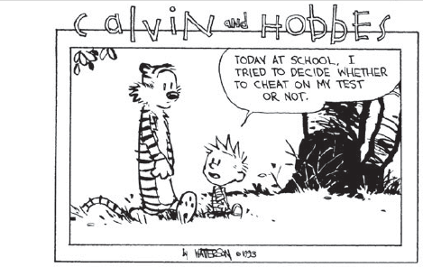
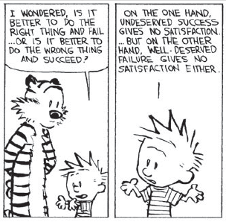
Ethics

Slide 3
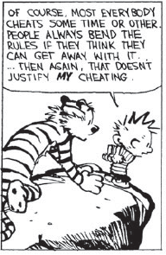
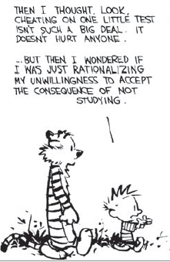
Ethics

Slide 4
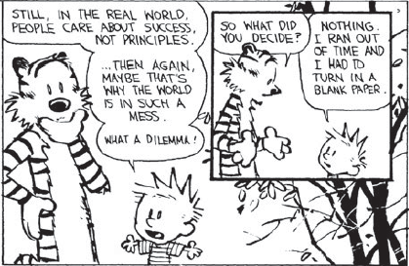
Ethics

Slide 5
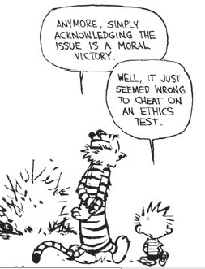
Ethics

Slide 6
Ethics
What is Ethics:
Ethic means the principals of Right and Wrong that are accepted by an individual or a social group.
Is a study of what is means to “Do the right thing”
Ethics means the Motivation based on ideas of right and wrong
The Philosophical (a belief accepted as authoritative by some group) study of Moral values and Rules to follow in our interactions and our actions that affect others

Slide 7
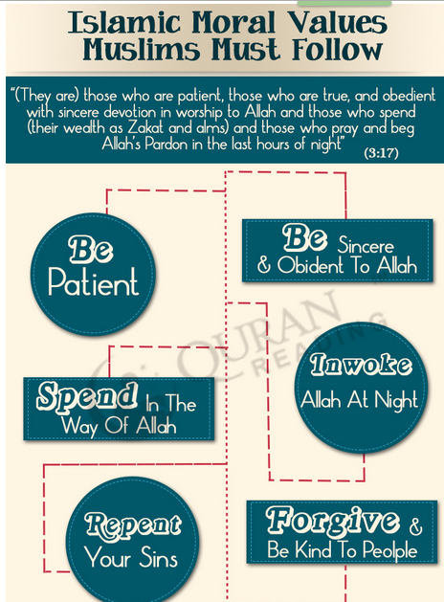
Moral Values of MUSLIMS

Slide 8
Ethics Theories
Deontological (Duty/Rights) Universality, Logic or reason
Deontologists tend to emphasize duty and absolute rules, to be followed whether they lead to good or ill consequences in particular cases. One example is: Do not lie. For example, if a person is looking for someone he intends to murder
Consequentialist (Actions evaluated on their con.)
Utilitarianism (Consequences of every action, ignores moral obligations)

Slide 9
Ethics Theories
Natural rights (Duty and Rights)
to let people make their own decisions an exclusive right to ourselves, our labor, and to what we produce with our labor. Thus, a natural right to property that we create or obtain by mixing our labor with natural resources, Clearing land and planting food would be pointless
Individuals basic rights should be respected by others.
Virtue and Moral: The first choice increases the person’s professional status and possibly the person’s salary; you could see it as a selfish choice. Doing one’s work (whether it is collecting garbage or performing brain surgery) honestly, responsibly, ethically, creatively, and well is a virtuous activity.

Slide 10
Ethics (cont.)
Important Distinctions:
Right, wrong and okay
it is better to think of acts as either ethically obligatory, ethically prohibited, or ethically acceptable.
Negative rights (liberties)
The right to act without interference, The rights to “life, liberty, and the pursuit
of happiness
Positive rights (claim-rights)
An obligation of some people to provide certain things for others, impose an obligation on some people to provide certain things for others. A positive right to a job means that someone must hire you,
A positive right to life means that some people are obligated to pay for food or medical care for others who cannot pay for them.

Slide 11
Ethics (cont.)
Important Distinctions:
Difference between wrong and harm
Carelessly and needlessly causing harm is wrong, but it is important to remember that harm alone is not a sufficient criterion to determine that an act is unethical. Many ethical, even admirable acts can make other people worse off, producing a better product, getting a job, there can be wrong when there is no (obvious or immediate) Harm. Some hackers argue that breaking into computer systems is not wrong, because they do no harm
Personal preference and ethics
Law and Ethics we are ethically obligated to obey such laws—not because they are laws, but because the laws implement the obligations and prohibitions of ethical rules.

Slide 12
Utilitarianism
Utilitarianism is a theory in normative ethics holding that the moral action is the one that maximizes utility.
Utility is defined in various ways, including as pleasure, economic well-being and the lack of suffering.
Happiness ☺
Satisfaction ☺

Slide 13
act utilitarianism and rule utilitarianism
Act utilitarianism is the belief that it is the right action that brings the greatest happiness to the greatest number of people. It is a concept that believes that the morality of an action is determined by its usefulness to most of the people that this act is in accordance with the moral rules since it brings greater good or happiness.
Rule utilitarianism on the other hand is the belief that an action can be morally right if it conforms to the rules that will lead to the greatest good or happiness. It adheres to the belief that the correctness of an action is determined by the correctness of its rules and that if the correct rule is followed, the greatest good or happiness is achieved.

Slide 14
IT Ethics
In order to promote ethical behavior we must also lay the ground work by promoting technological literacy.
It discusses the issues that are related to ownership, access, privacy, community and security, the areas that are open to ethical dilemmas in the world of information technology and are increasingly becoming prevalent on society.
BOOK: ETHICS FOR I.T. PROFESSIONALS WITH ASPECTS IN COMPUTING by Charlemagne G. Lavina, Melchor G. Erise, Coeazon B. Rebong, Susan S. Caluya (MINDSHAPERS CO.,INC. 61 Muralla St., Intramuros, Manila, Philippines)

Slide 15
Ethics now Corporate Policies
In order to combat the recent corporate scandals and protect the companies reputation, companies have begun form more comprehensive corporate policies concerning ethics.
These policies generally offers guidance to employees as well as stating the companies expectations.
In order to work companies may require employees to sign a contract stating they will follow the procedures stated within the handbook.
Many companies have begun to explore why employees would behave unethically.

Slide 16
Laws and IT
Securities and Exchange Commission (SEC), 1933
Computer Fraud and Abuse Act (CFAA), 1984 & 1994
Computer Security Act,
1987 Privacy Act,
1974 Electronic Communications Privacy Act Communications Decency Act,
1995 Health Insurance Portability & Accountability Act, (HIPAA) 1996 Sarbanes-Oxley Act of 2002
Homeland Security Act of 2002 with the Cyber Security Enhancement Act BY DICKSON 19 October 2013.

Slide 17
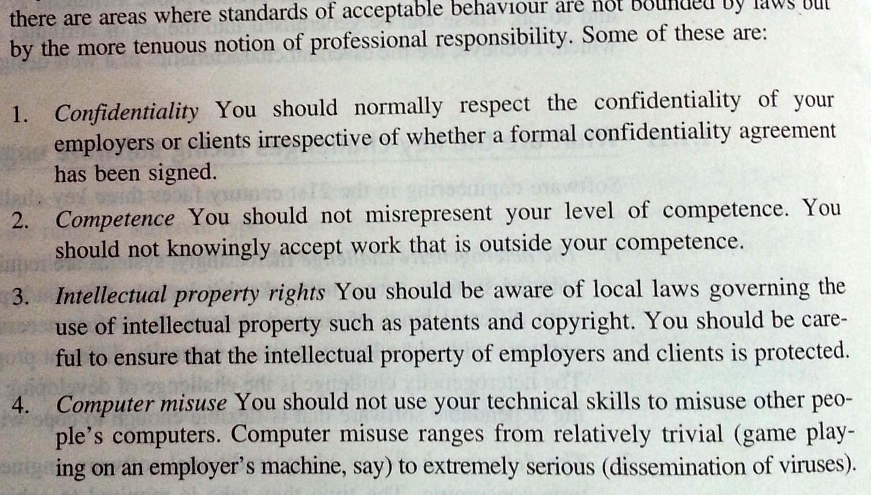
Professional Responsibilities for SW engineers

Slide 18
Software engineering code of ethics
HISTORY
IEEE Board of Governors established steering committee (May, 1993).
ACM Council endorsed Commission on Software Engineering (Late 1993).
Joint steering committee established by both societies (January, 1994).

Slide 19
Research
Review of available computing and engineering codes:
The American Association of Engineering Societies
Accreditation Board for Engineering Technology
ACM’s Code of Ethics for Professional Conduct
The British Computer Society Code of Practice
Institute for the Certification of Computing Professionals
Engineer’s Council for Professional Development
The IEEE Code of Ethics
National Society of Professional Engineers Code of Ethics
Project Management Institute Code of Ethics

Slide 20
8 Key Principles:
Product
Public
Judgement
Client and Employer
Management
Profession
Colleagues
Self

Slide 21
Principle 1: Products
1.01 Ensure adequate software specification
1.02 Understand specifications fully
1.03 Ensure you are suitably qualified
1.04 Ensure all goals are achievable
1.05 Ensure proper methodology use
1.06 Ensure good project management
1.07 Ensure all estimates are realistic
1.08 Ensure adequate documentation
1.09 Ensure adequate testing and debugging
1.10 Promote privacy of individuals
1.11 Use data legitimately
1.12 Delete outdated and flawed data
1.13 Identify and address contentious issues
1.14 Promote maximum quality and minimum cost
1.15 Follow appropriate industry standards

Slide 22
Principle 2: Public
2.01 Disclose any software-related dangers
2.02 Approve only safe, well tested software
2.03 Only sign documents in area of competence
2.04 Cooperate on matters of public concern
2.05 Produce software that respects diversity
2.06 Be fair and truthful in all matters
2.07 Always put the public’s interests first
2.08 Donate professional skills to good causes
2.10 Accept responsibility for your own work

Slide 23
Principle 3: Judgement
3.01 Maintain professional objectivity
3.02 Only sign documents within your responsibility
3.03 Reject bribery
3.04 Do not accept secret payments from the client
3.05 Accept payment from only one source for a job
3.06 Disclose conflicts of interest
3.07 Avoid conflicting financial interests
3.08 Temper technology judgments with ethics

Slide 24
Principle 4: Client and Employer
4.01 Provide services only where competent
4.02 Ensure resources are authentically approved
4.03 Only use property as authorized by the owner
4.04 Do not use illegally obtained software
4.05 Honor confidentiality of information
4.06 Raise matters of social concern
4.07 Inform when a project becomes problematic
4.08 Accept no detrimental outside work
4.09 Represent no interests adverse to your employer

Slide 25
Principle 5: Management
5.01 Assure standards are known by employees
5.02 Assure knowledge of confidentiality protocols
5.03 Assign work according to competence
5.04 Provide due process for code violations
5.05 Develop fair ownership agreements
5.06 Accurately describe conditions of employment
5.07 Offer only fair and just remuneration
5.08 Do not prevent a subordinate’s promotion
5.09 Do not ask a person to breach this code

Slide 26
Principle 6: Profession
6.01 Associate with reputable people
6.02 Promote commitment of this code
6.03 Support followers of this code
6.04 Help develop an ethical environment
6.05 Report suspected violations of this code
6.06 Take responsibility for errors
6.07 Only accept appropriate remuneration
6.08 Be accurate and honest regarding software
6.09 Place professional interests before personal
6.10 Obey all laws governing your work
6.11 Exercise professional responsibility
6.12 Promote public knowledge of the subject
6.13 Share software knowledge with the profession

Slide 27
Principle 7: Colleagues
7.01 Assist colleagues in professional development
7.02 Review other’s work only with their consent
7.03 Credit fully the work of others
7.04 Review others work candidly
7.05 Give fair hearing to colleagues
7.06 Assist colleagues’ awareness of work practices
7.08 Do not hinder a colleague’s career
7.09 Do not pursue a job offered to a colleague
7.10 Seek help with work outside your competence

Slide 28
Principle 8: Self
8.01 Further your own professional knowledge
8.02 Improve your ability to produce quality work
8.03 Improve your ability to document work
8.04 Improve your understanding of work details
8.05 Improve your knowledge of relevant legislation
8.06 Improve your knowledge of this code
8.07 Do not force anyone to violate this code
8.08 Consider code violations inconsistent with
software engineering

Slide 29
Short version, 1 of 2
1. PUBLIC - Software engineers shall act consistently with the public interest.
2. CLIENT AND EMPLOYER - Software engineers shall act in a manner that is in the best interests of their client and employer, consistent with the public interest.
3. PRODUCT - Software engineers shall ensure that their products and related modifications meet the highest professional standards possible.
4 . JUDGMENT - Software engineers shall maintain integrity and independence in their professional judgment.

Slide 30
Short version, 2 of 2
5. MANAGEMENT - Software engineering managers and leaders shall subscribe to and promote an ethical approach to the management of software development and maintenance.
6. PROFESSION - Software engineers shall advance the integrity and reputation of the profession consistent with the public interest.
7. COLLEAGUES - Software engineers shall be fair to and supportive of their colleagues.
8. SELF - Software engineers shall participate in lifelong learning regarding the practice of their profession and shall promote an ethical approach to the practice of the profession.

Slide 31
Examples
Brief example of specific points
Not comprehensive

Slide 32
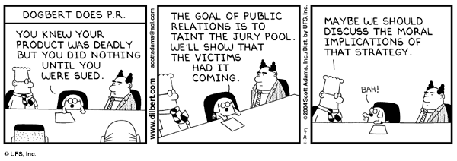
Public
1.04. Disclose to appropriate persons or authorities any actual or potential danger to the user, the public, or the environment, that they reasonably believe to be associated with software or related documents.

Slide 33
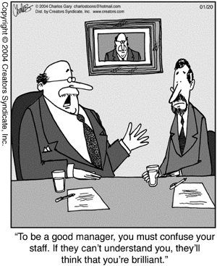
Management
5.01 Ensure good management for any project on which they work, including effective procedures for promotion of quality and reduction of risk.

Slide 34
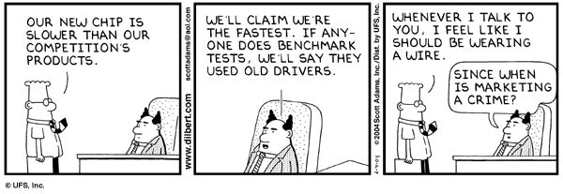
Profession
6.07. Be accurate in stating the characteristics of software on which they work, avoiding not only false claims but also claims that might reasonably be speculative, vacuous, deceptive, misleading, or doubtful.

Slide 35
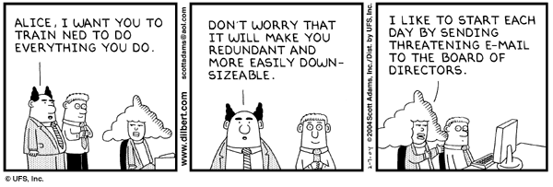
Colleagues
7.02. Assist colleagues in professional development.

Slide 36
Law in Pakistan
Assignment # 2
Part 1:
What kind of ethical issues related to IT we are facing today? List at least 5 different issues with real life examples.
Part 2:
Pakistan National Assembly has passed a cybercrime bill in 2016. Read the clauses of that bill and mention the clauses which cover the issues you have highlighted in part1.

